Slide 1
12 Years of Student Technology Ownership Surveys: Trends & Today’s Opportunities for Richer Learning Experiences
Take the CALI Con 16 Technology Survey while you wait: goo.gl/wY9sk1
CALI Conference, June 2016, Atlanta, GA
Rich McCue: rmccue@uvic.ca - Will Monroe: will.monroe@law.lsu.edu

Slide 2
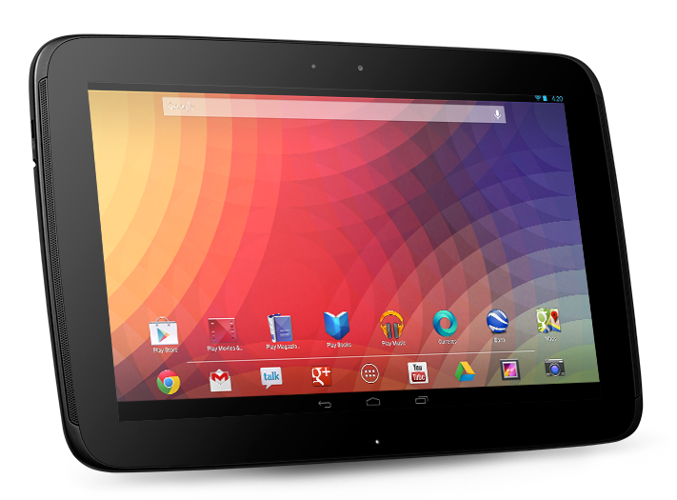
Current Research Purpose:
1. Identify the technologies students are using in their personal and academic lives.
3. Look for ways to provide equitable access to technology for Students.
2. Facilitate the educational use of personal technology by students.
Notes:
The Current Purpose of the survey was to:
Identify the technologies students are using in their personal and academic lives.
Explore ways to facilitate the educational use of their personal technology for research and class related work.
Look for ways to provide equitable access to technologies for those who cannot afford to purchase it for themselves.
Highlight ways instructors can leverage personal technologies for more engaging and effective instruction.

Slide 3
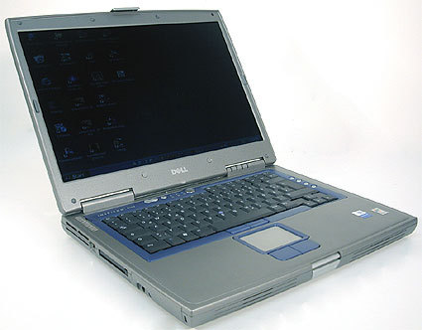
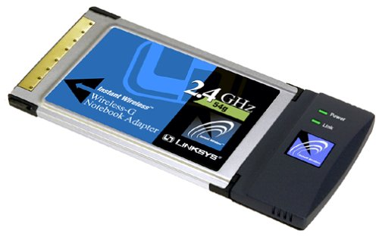
Original 2003 Research Purpose:
Notes:
The Original Purpose of the survey back in 2003 at UVic was to:
Figure out how many students were arriving at law school with laptops
Find out how much they paid for them, and how old they were.
[NEXT] Find out who had wifi capability built in to potentially justify a larger rollout of wifi in the building.

Slide 4
LSU Surveys Started in 2008?
Notes:
[WILL]
LSU began surveys in 2008. Driven by an interest in student laptop ownership and possible laptop requirement
LSU, UVic and others shared survey items in 2012

Slide 5
MOBILE DEVICES
Types owned
Service provider used
University-related usage
COMPUTING & INTERNET
Laptops – types & usage
Tablet & eReader usage
In-class note-taking tools
Internet access
File backup methods & Printing
Experience with online courses
Current
SURVEY QUESTIONS
E-MAIL & COLLABORATION
Primary email account
Campus email usage
Collaborative document editing tools
Audio-video collaboration tools
SOCIAL MEDIA
Tools
University-related usage
Notes:
[WILL]
The questions we asked were clustered around the topics relating to what hardware and applications students are using and for what purpose:
Mobile Devices
Email & Collaboration
Computing & Internet
Social Media

Slide 6
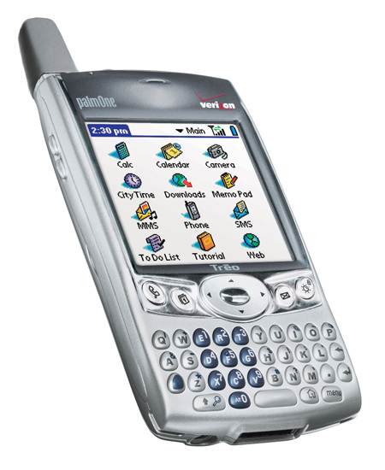
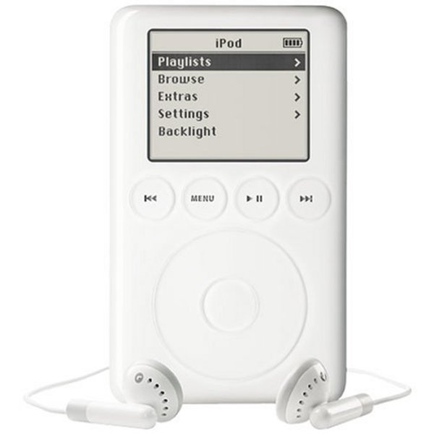
WayBack Machine: 2003 Law Student Tech
Notes:
Back when the 1st survey was conducted in 2003:
[NEXT] Finding Nemo was hot…
[NEXT] The cool high tech cell phone was the Palm Treo...
[NEXT] The iTunes music store was just released...
[NEXT] And The US forces were hailed as liberators in Iraq.

Slide 7
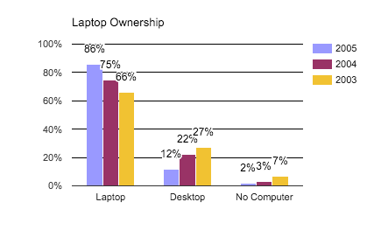
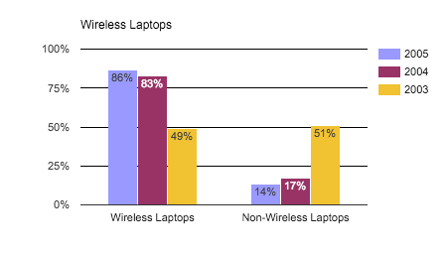
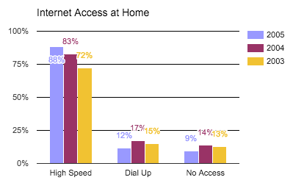
WayBack Machine: 2003 Law Student Tech
Notes:
Meanwhile among 1st year UVic Law Students:
Laptop ownership hit 66%
[NEXT] Only 49% of those laptops were wireless capable (built-in or add-on card)
[NEXT] High speed internet access at home was at 72%

Slide 8
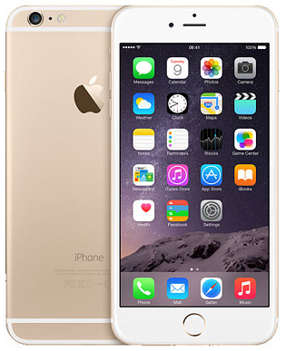
Fast Forward: 2015 Student Survey
Notes:
Now in 2015:
[NEXT] Star Wars the Force Awakens is the hot new movie…
[NEXT] The cool high tech cell phone is arguably the iPhone 6S...
[NEXT] Virtual Reality products are becoming more popular...
[NEXT] The US still has 12,000 troops in Iraq along with 2 aircraft carriers.

Slide 9
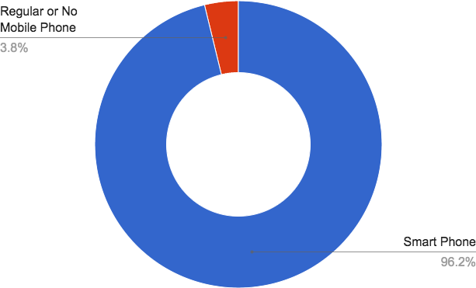
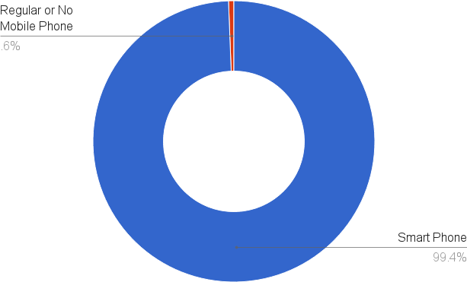
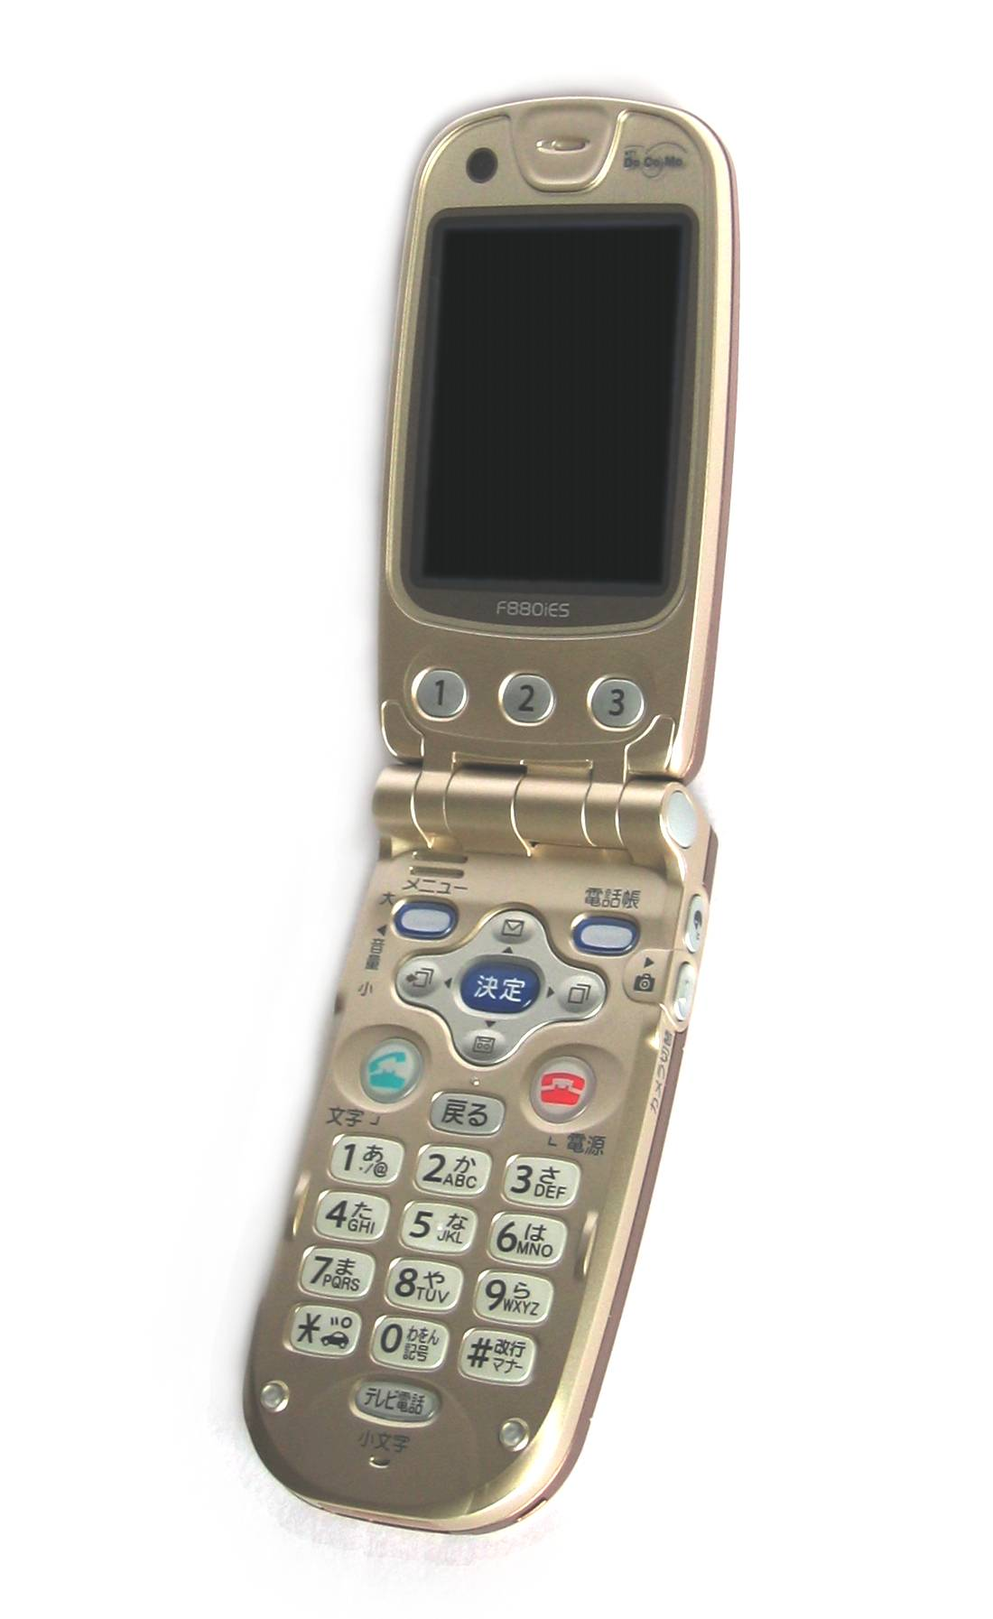
SmartPhone / Cell Phone Ownership
LSU
UVic
Notes:
Let’s start by looking at cell phone ownership...
Currently at UVic 96% of students own smartphones (iPhones or Android), and
At LSU 99% own smartphones, and only one student owns a feature phone.

Slide 10
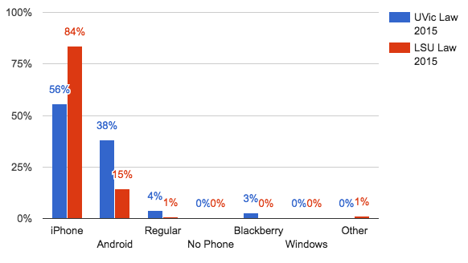
SmartPhone / Cell Phone Ownership
Notes:
When we look at the breakdown of phone brands we see lot’s more iPhones at LSU than UVic for some reason.
Network effect?
… AND… RIP Blackberry...

Slide 11
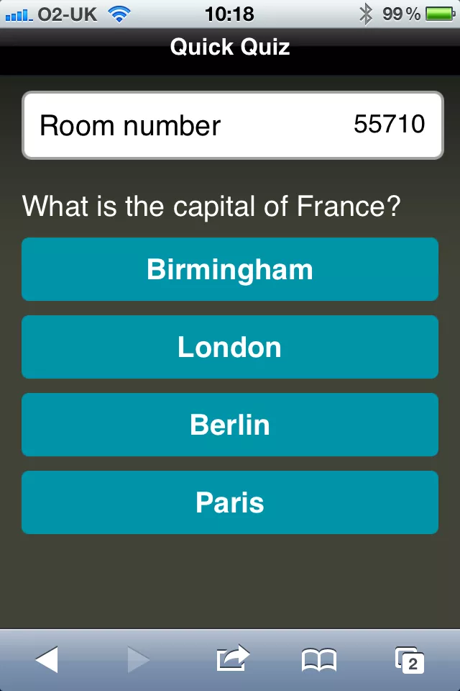
SmartPhone Opportunities
Notes:
Smartphone are ubiquitous… not only in ownership, but also in the probability that they will have it with them at school (as we will shortly see is not necessarily the case with laptops). These smartphones can facilitate...
[NEXT] In-class feedback, esp in large classrooms.
Moodle choice-based quizzes followed by socratic questioning. Not easy in a class of 100 w/o ubiquitous phone ownership.
Also leaves faculty feedback during/after class--are students getting it?
[NEXT] Quick reference during in class group work.

Slide 12
Laptop Ownership
LSU
UVic
Notes:
In terms of laptops owned by students, Windows and Macs are the two major players…
But we know where the really tech savvy future lawyers are…
[NEXT] And, it’s not LSU! ;-)

Slide 13
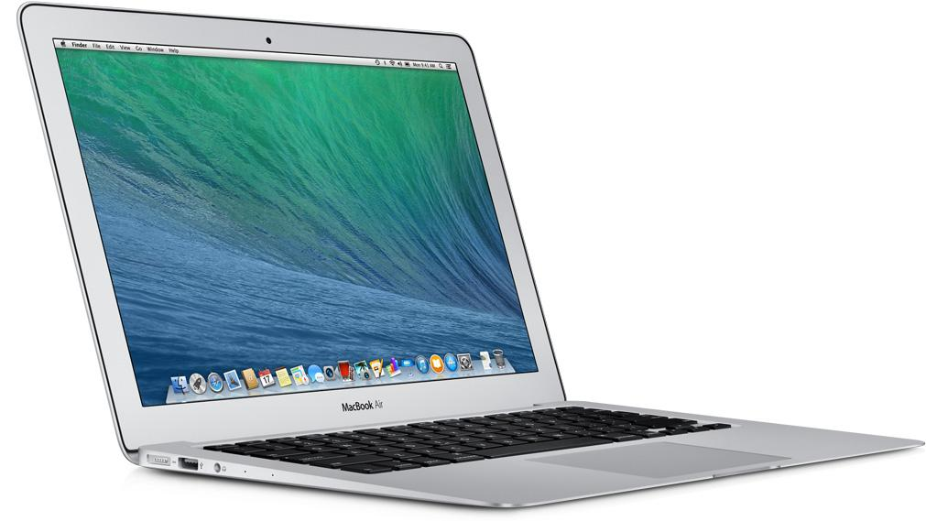
Laptop Ownership
Notes:
As you might guess, 100% of students arrived at law school with a laptop.
But how often do students who own laptops actually bring their laptops to campus?

Slide 14
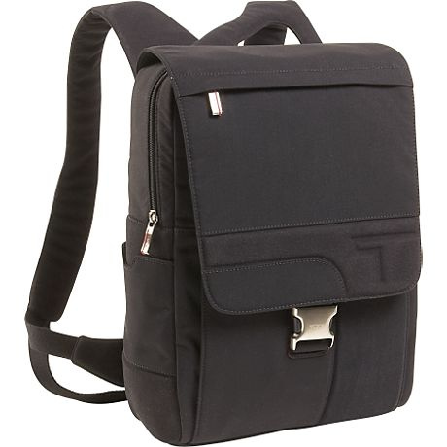
Students Bringing Laptops to Campus
LSU
UVic
Notes:
77% of students bring their laptops to school regularly, 24% occasionally or never bring them to campus.
The 24% of student who occasionally or never bring a laptop to campus = about 90 students in daily in the building w/o laptops.
This explains why computer labs are still in use despite almost all students owning laptops..
LSU Law has a three Library kiosk PCs but not an always open computer lab anymore

Slide 15
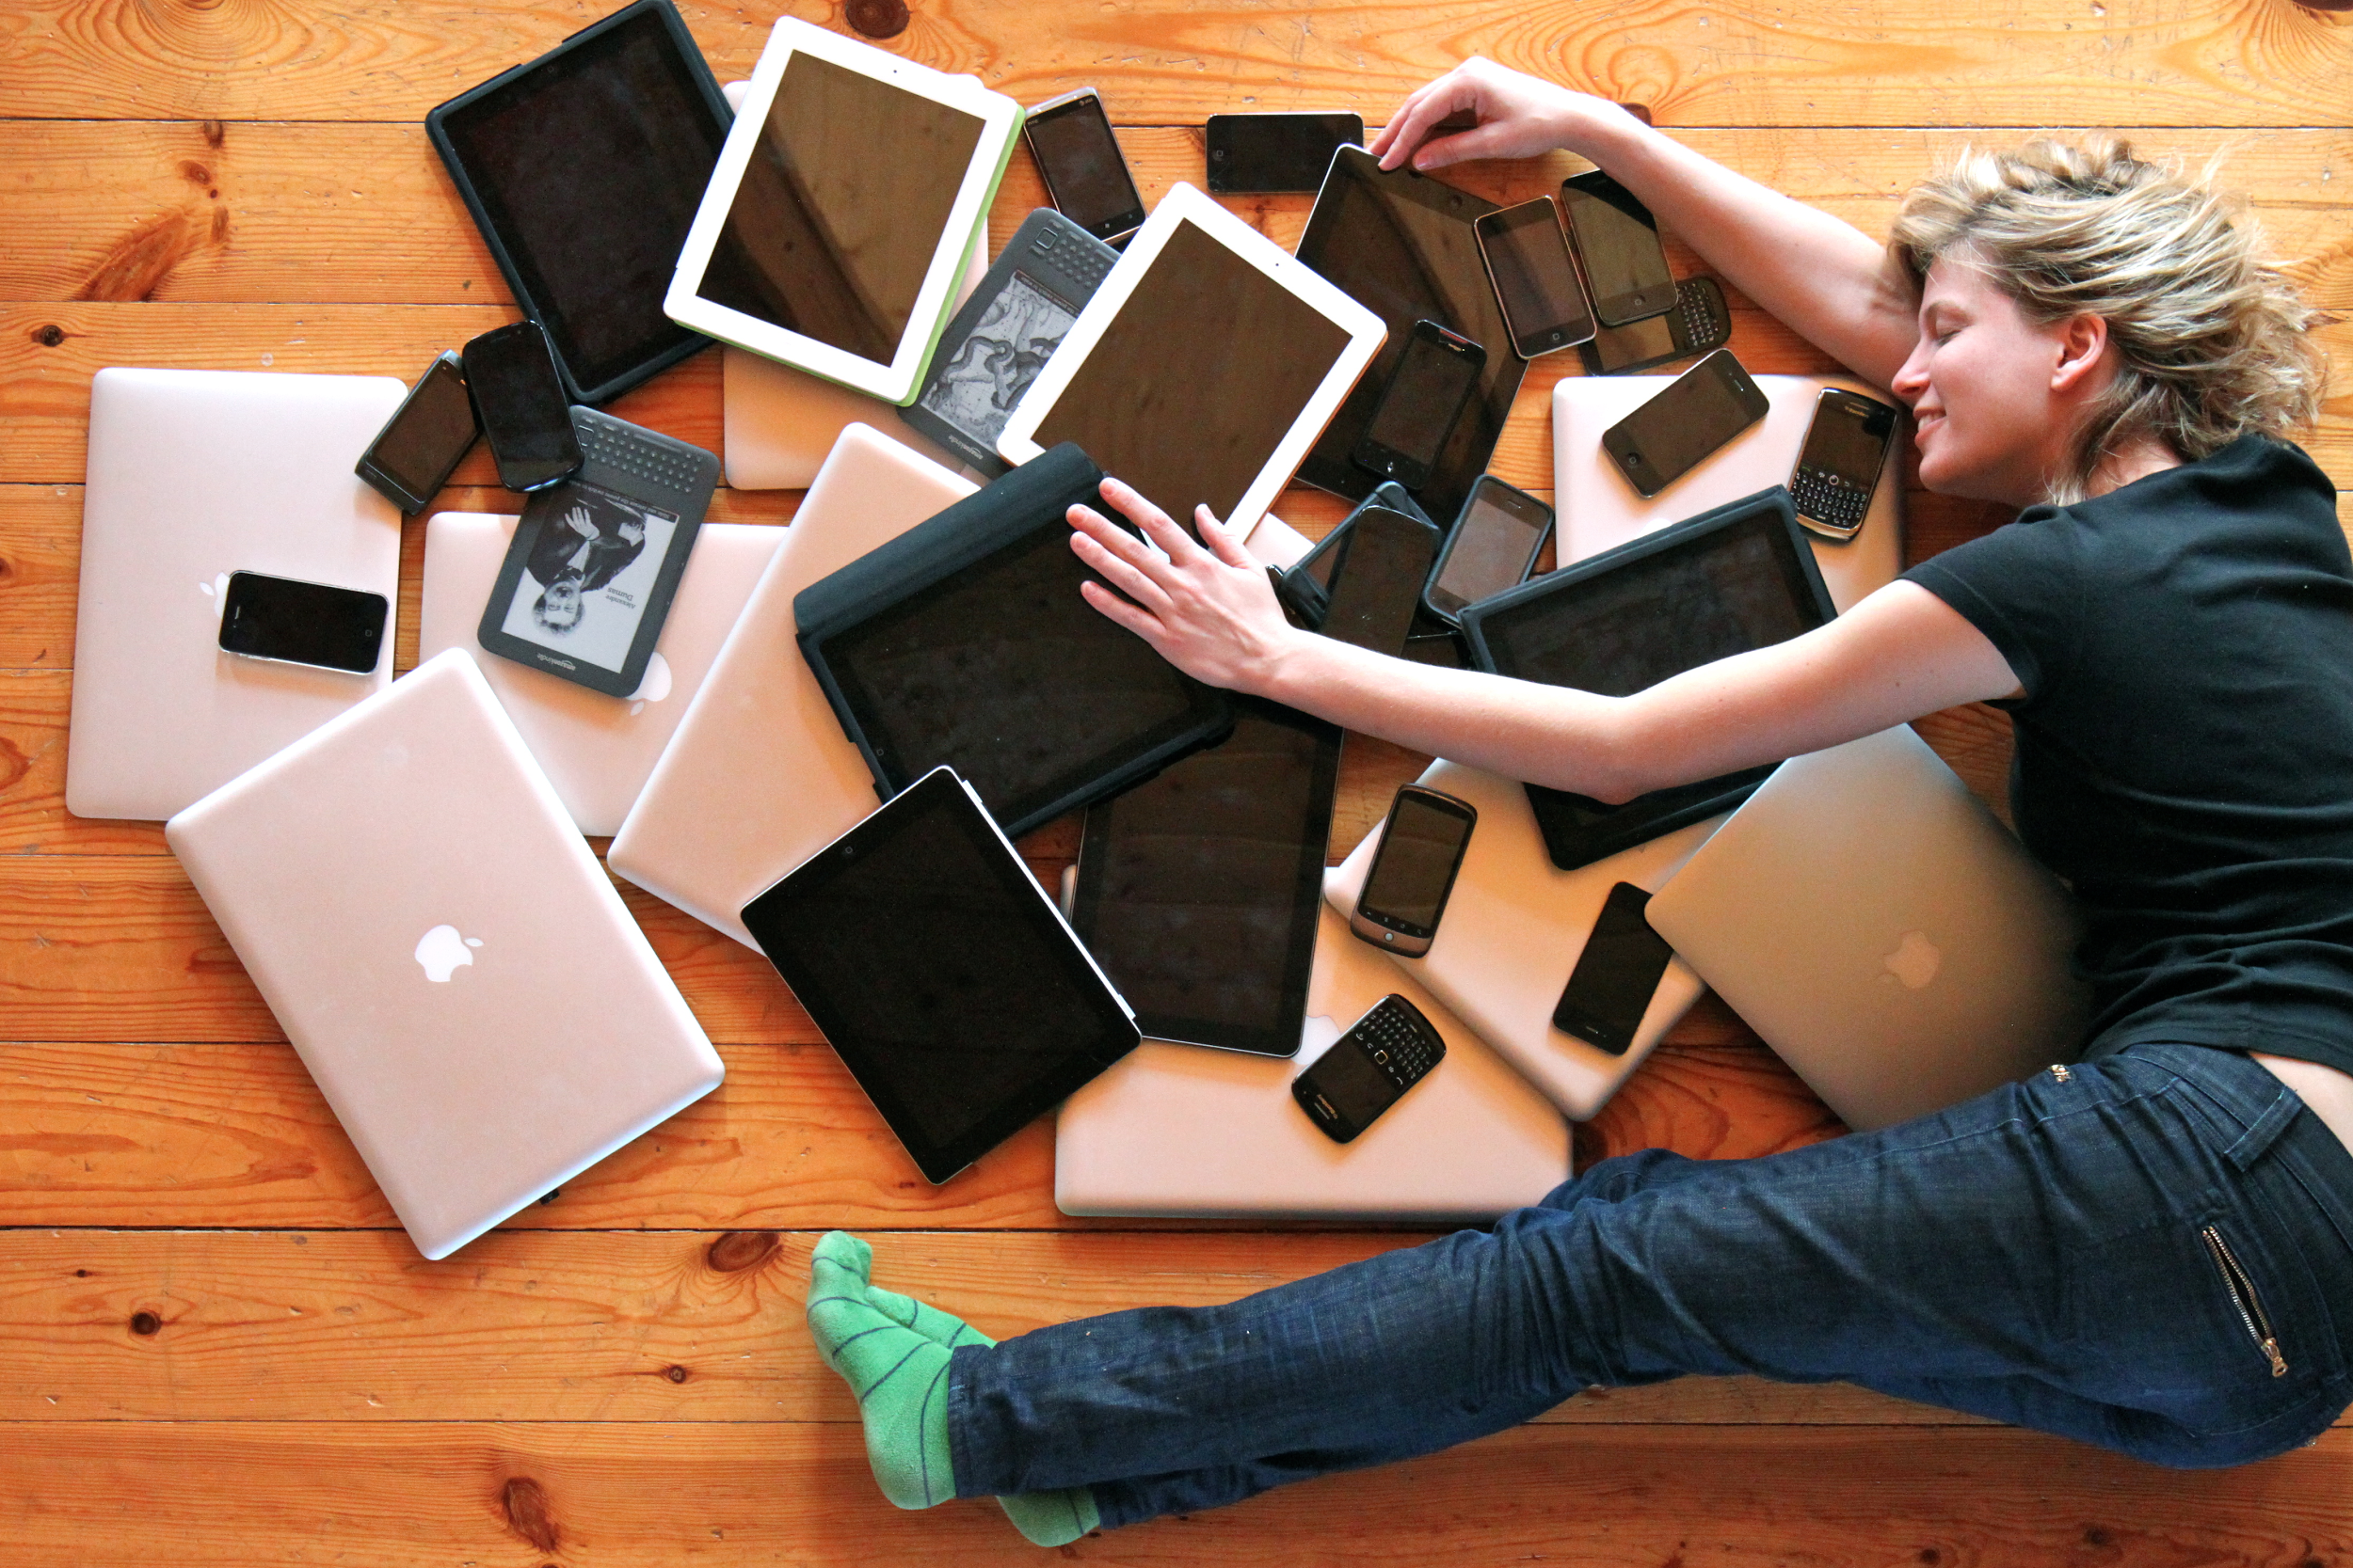
Proliferation of Devices...
Notes:
[WILL]
Proliferation of all these devices: You need good wireless service
Recent upgrades to address weak coverage and student device proliferation
Strong coverage allows applications like TurningPoint Cloud service that uses mobile devices.

Slide 16
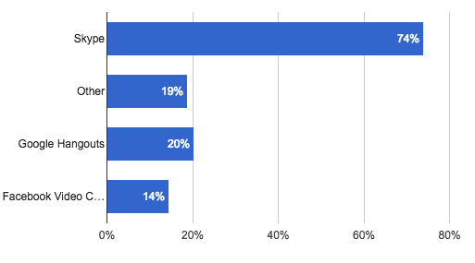
Real-Time Audio & Video Collaboration
Notes:
Next we asked about real time video and audio collaboration:
Skype dominates with 74% of students using it.

Slide 17
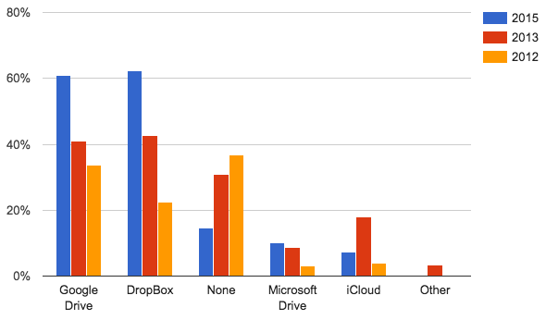
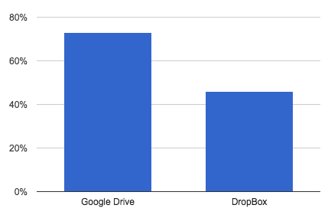
Collaborative Document Editing
LSU
Notes:
When asked about collaborative document editing:
At UVic 61% use Google Drive & 62% Dropbox. You can see the changed over time.
[NEXT] At LSU 73% use Google Drive & 46% use Dropbox.
The numbers of students using “cloud” tools is growing every year as the tools become more capable and convenient.

Slide 18
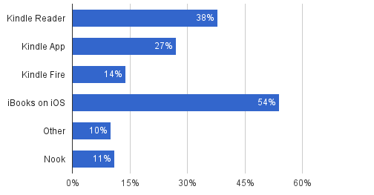
Tablet & EBook Reader Ownership
Notes:
[WILL]
LSU Law data from 2015
Began surveying about ebook ownership in 2012, prompted by administration interest in digital texts and course packs
Surprised to see so many iBooks users
Other...students mentioned “laptop” as an alternate ebook device

Slide 19
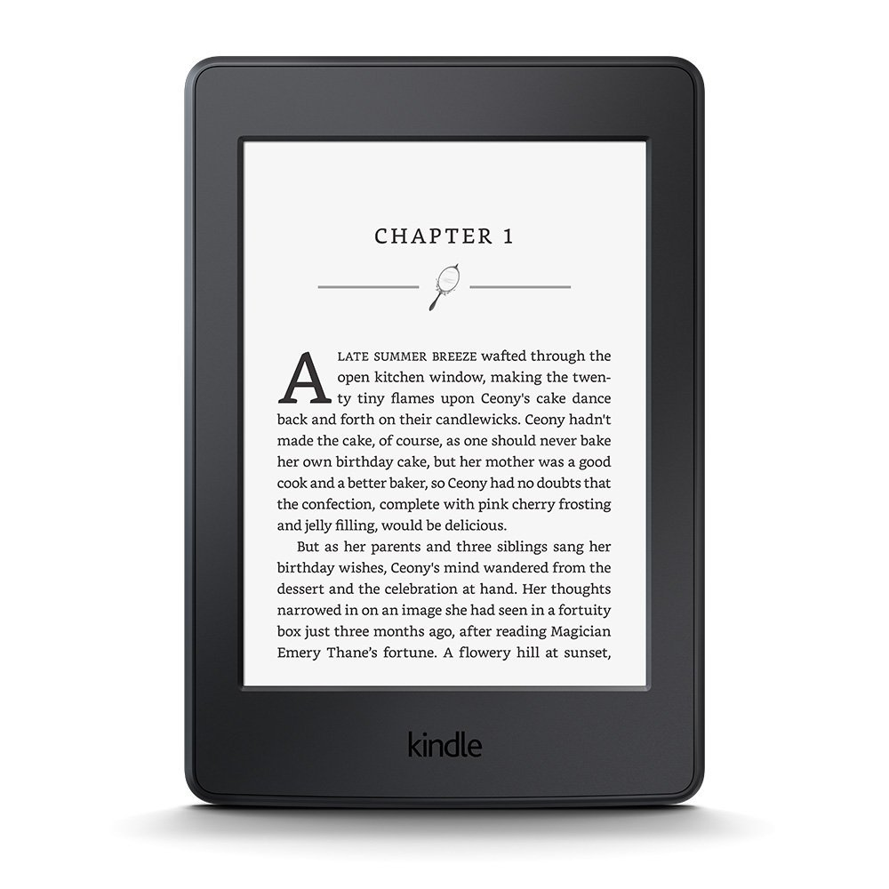
EBooks for Pleasure or Research?
Notes:
[WILL]
LSU Law data from 2015
Q: “Have you read ebooks for pleasure?” 64% yes & 36% no.
[NEXT] Q: “Have you read ebooks for for research or non-class scholarship?” 42% yes & 58% no.

Slide 20
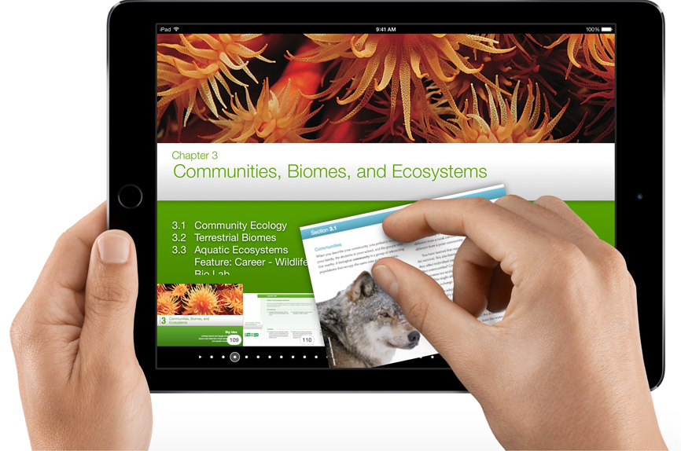
Do LSU Students want eTextbooks?
Cheaper alternatives
“Online books/supplements (particularly supplements) would be nice. Books are obviously expensive and it would be great if we had a cheaper alternative.” (2015)
Distinction between formats
“Make secondary textbooks, but not casebooks, available on Kindle” (2012)
“Nothing...can replace a real book...highlight everything I want...write notes on the margins...quickly skim the pages to look for something.” (2014)
Notes:
[WILL]
Q: “Are you interested in using completely online/electronic textbooks in law school?”-- from 2015
A: 27% want eTextbooks
Cheaper alternatives
2015 “Online books/supplements (particularly supplements) would be nice. Books are obviously expensive and it would be great if we had a cheaper alternative.”
2014 “Link books to online and to ebook options”
Distinction between different formats
2012 “Make secondary textbooks, but not casebooks, available on Kindle”
2012 “Electronic textbooks that are tablet-ready would be a major boon for my personal studies as I use my tablet often for keeping notes and tasks organized.”
2014 “nothing, at least for me, can replace a real book, where I can physically highlight everything I want, and write notes on the margins, and quickly skim the pages to look for something.”

Slide 21
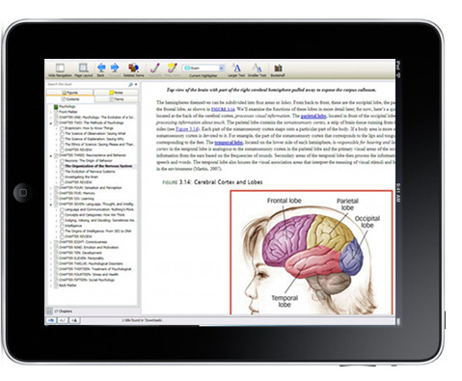
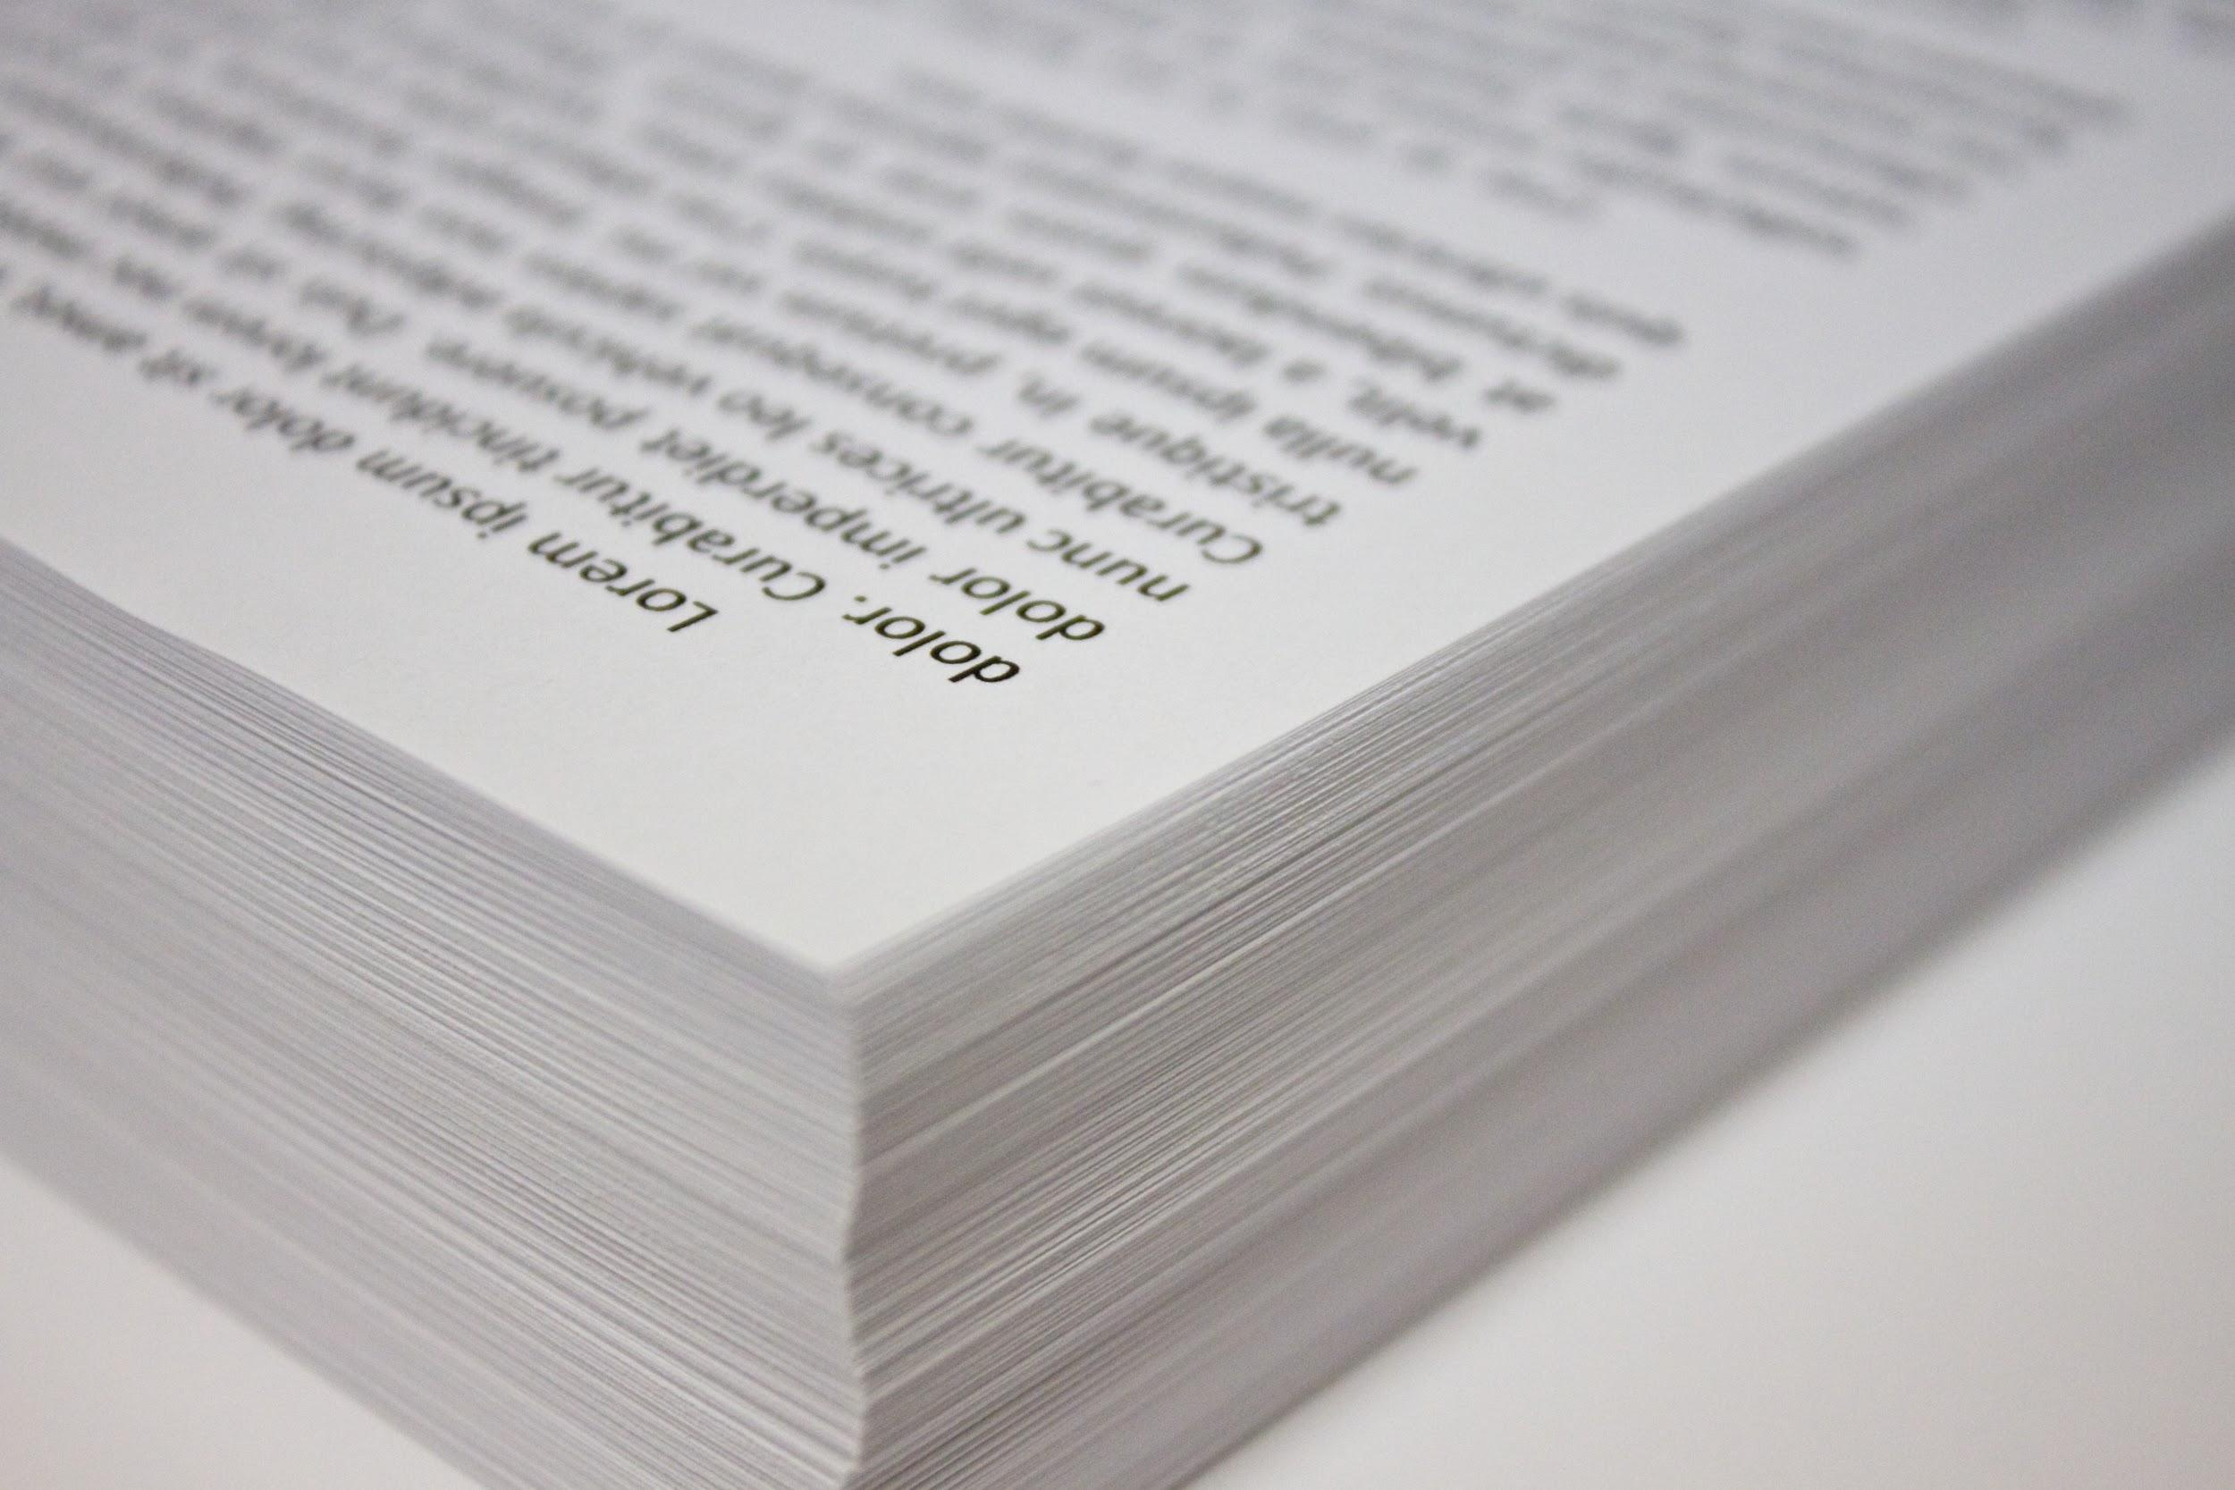
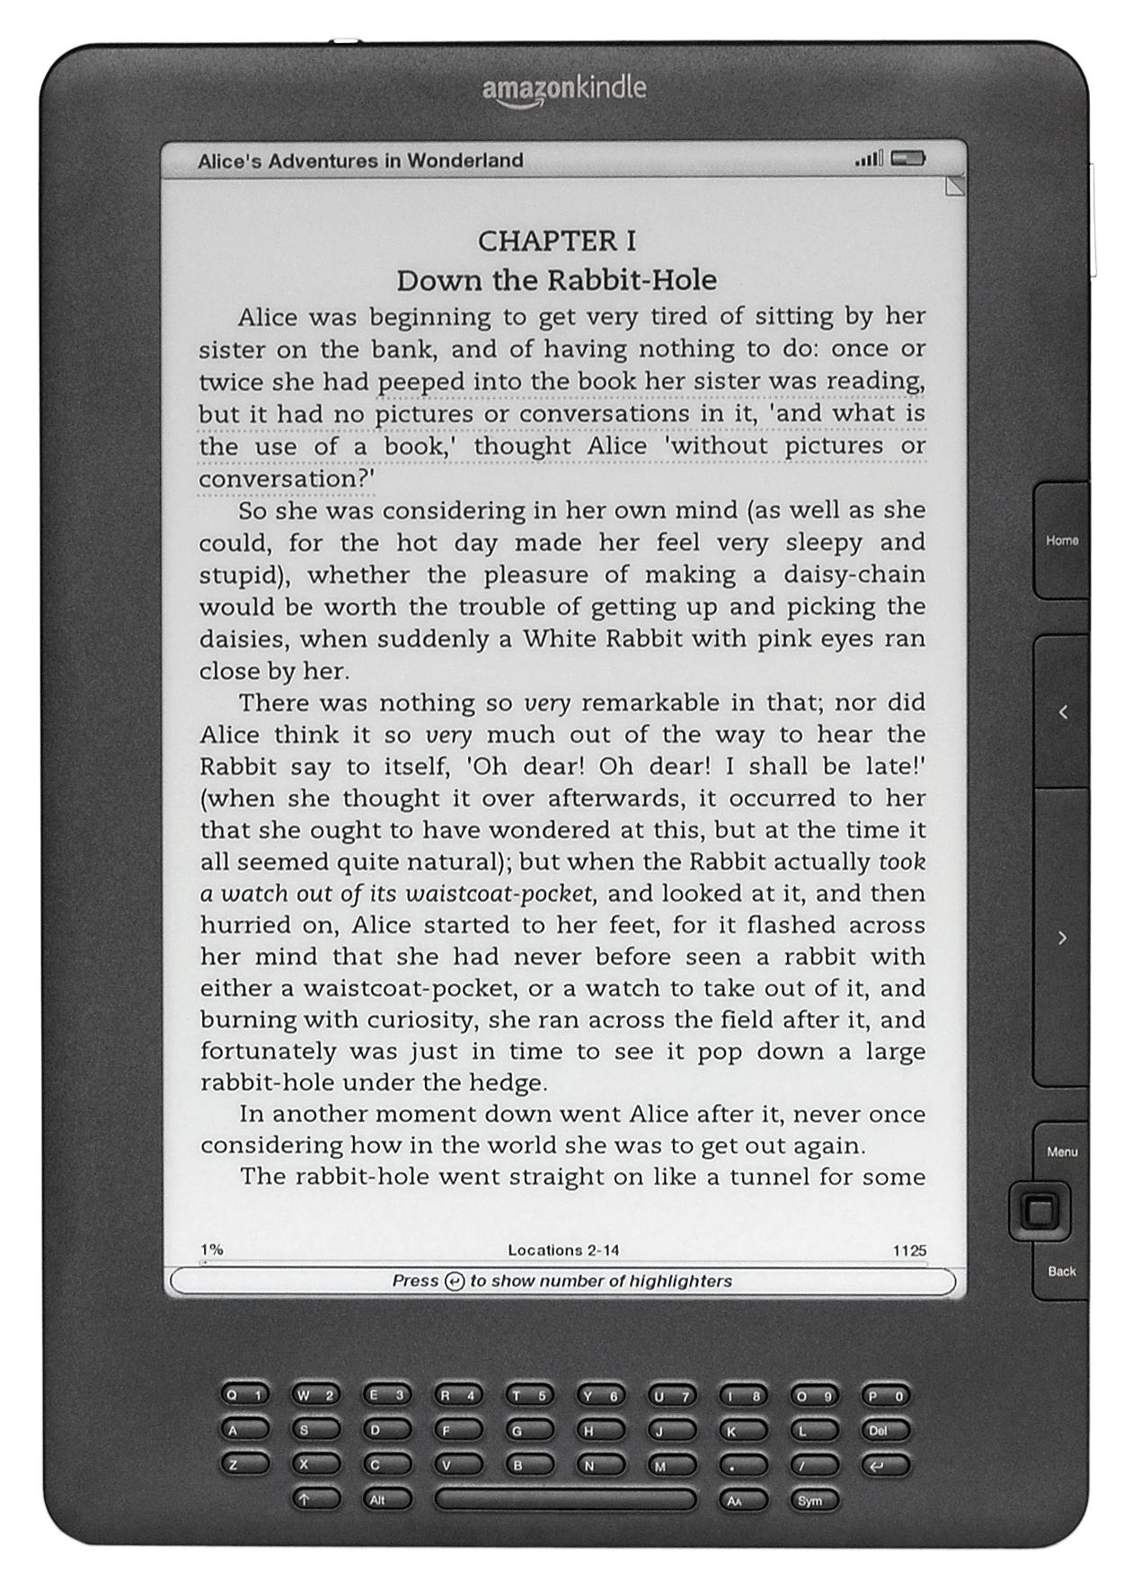
eBook & Tablet Opportunities
Notes:
Assuming continued growth in tablet ownership:
We should give serious consideration to creating coursepacks in eBook as well as paper format whenever possible.
We should also consider training to encourage professors to purchase textbooks available in eBook as well as print formats, so that those who want them can use them. -> I personal like my textbooks on my laptop.
We should note that almost all Open Access textbooks are freely available in eBook format, including those offered by CALI via eLangdell -> Using these textbooks have the added virtue of reducing the cost of education for our students.

Slide 22
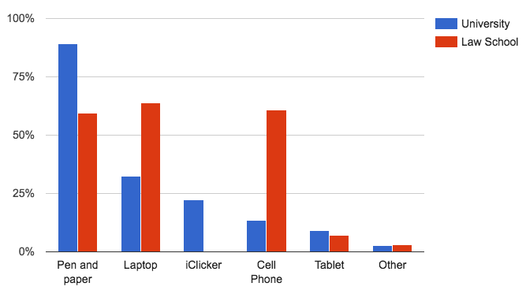
Note Taking Tools
Notes:
Our question about note taking produced some interesting results. Students report that:
Almost equal amounts use pen & paper AND laptops, compared to the rest of the university that prefer pen & paper.
NOTE: we did not ask how often they used each note taking method, just if they used them.

Slide 23
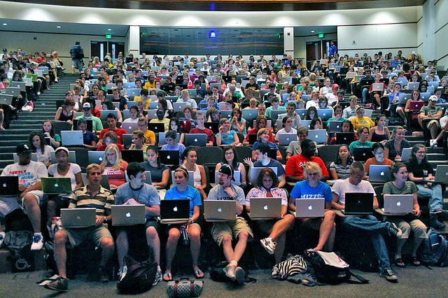
Note Taking / Mobile
Technology Implications
Notes:
[WILL]
LSU Law didn’t survey student note taking -- will do so next year
2015 study from Princeton & UCLA compared students who took handwritten notes to students who took notes with a laptop during a lecture.
Both groups well on factual recall questions--Approximately how many years ago did the Indus civilization exist?
Handwritten better on conceptual understanding--How do Japan and Sweden differ in their approaches to equality within their societies?
Q: Any ideas why laptop note takers remember less than their pen & paper counterparts? -> process lecture content at shallower levels therefore remember less.
Princeton and UCLA study:
Researchers told some of the laptop note takers not to simply transcribe the lecture but to take notes in their own words--made no difference, laptop note takers still transcribed.
Might be interesting to study how effective the 60% of students who use their cell phone are in note taking… might be more effective than laptop transcription because on a cell phone students would be forced to summarize which is an excellent way to help process more deeply & remember things.
Note taking literature review from Williams and Eggert (2002):
“Most effective notes highlight an overall framework for a lecture and embellish that framework with critical specifics.”

Slide 24
Laptop Bans...
“Mandate that professors to allow laptops in class. Last semester, I nearly failed a class and I solely attribute it to a no laptops policy. I cannot handwrite notes in a timely manner, which leads to me falling behind and missing significant parts of the lecture.”
Notes:
[WILL]
In 2012 LSU specifically asked about laptop bans. In subsequent years, we didn’t asked but continued to receive comments.
No handwriting skills
Above example: “Mandate that professors to allow laptops in class. Last semester, I nearly failed a class and I solely attribute it to a no laptops policy. I cannot handwrite notes in a timely manner, which leads to me falling behind and missing significant parts of the lecture.”
Many comments
Complaints about speed of handwritten notes--lack of experience with handwritten note taking.
Does this also mean lack of experience summarizing, paraphrasing?
Difficult to manage handwritten notes AND digital notes
Some students just wanted consistency
Bans prevent in-class research

Slide 25
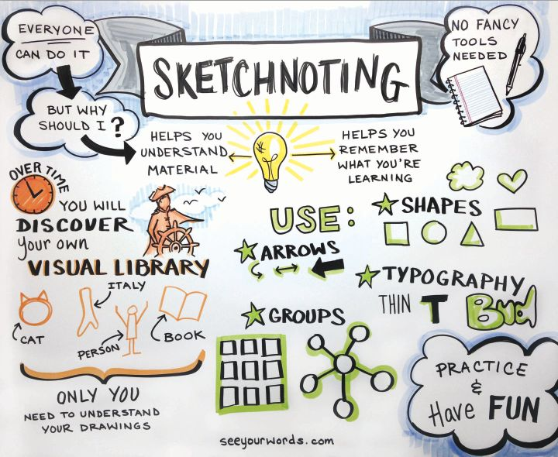
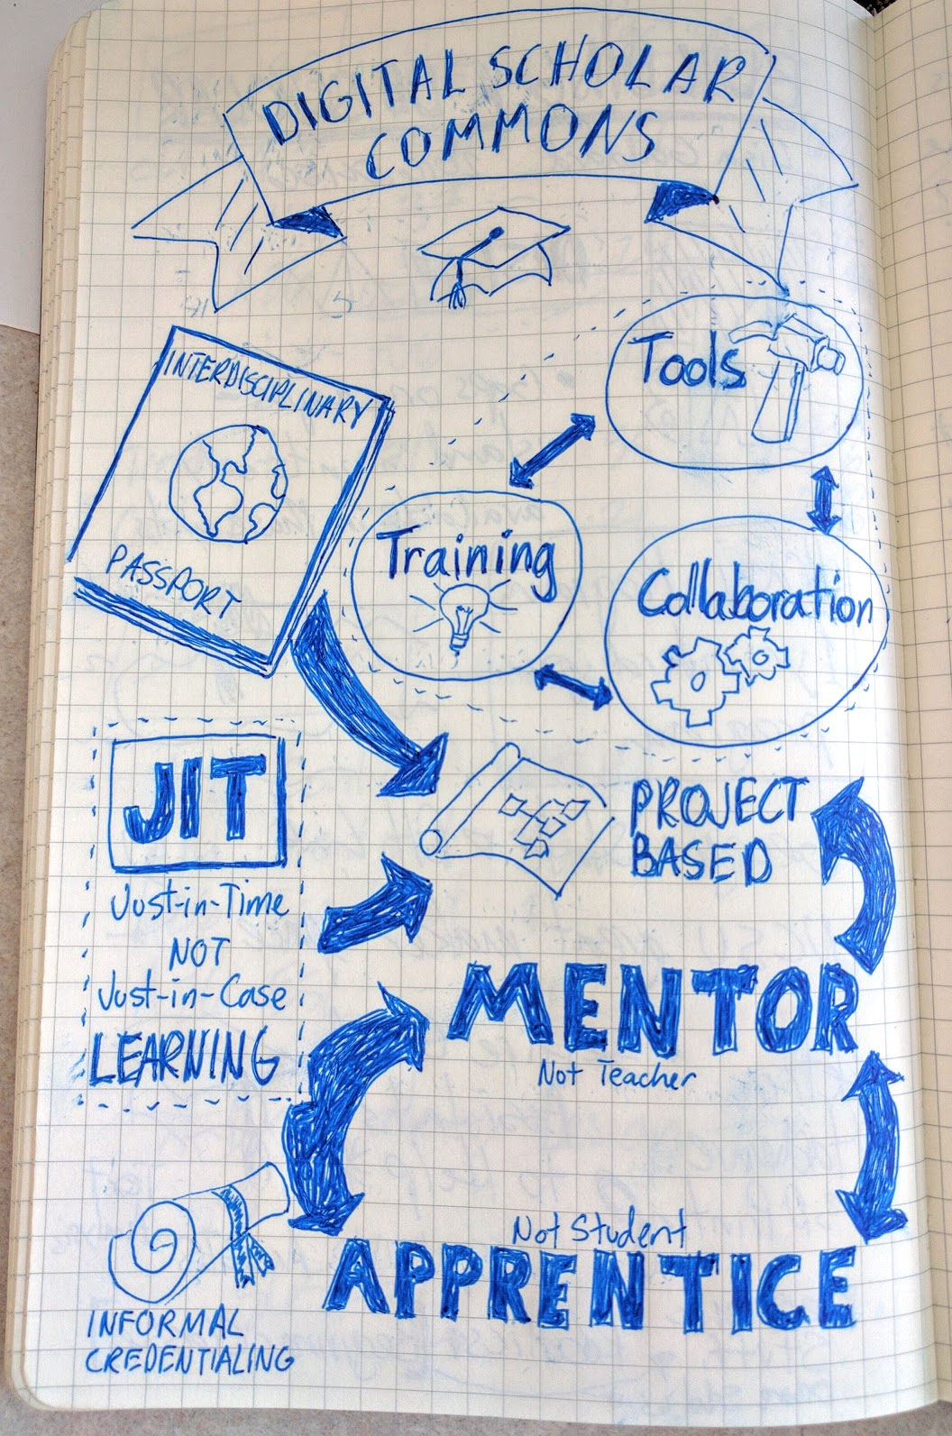
Sketchnoting?
Notes:
Maybe there is a need for training around how to take effective notes…
[NEXT]Sketchnoting is one method.
This builds on research from the Allan Paivio's Dual Coding Theory. Sketchnotes employ both the verbal and visual channels in which the brain processes information through sketches and words. -> More memorable
[NEXT] The process of sketching also forces us to think more abstractly about key concepts and how they relate to other ideas.
One of Rich’s Sketchnotes...

Slide 26
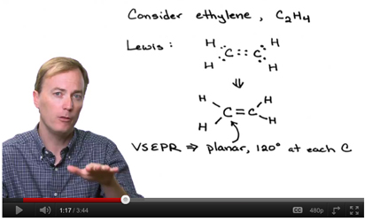
Laptops & Mobile Devices Enable Pedagogical Opportunities
More Engaging Constructivist, Activities When Face-to-Face.
http://today.duke.edu/2012/05/teamlearning
Notes:
One way to encourage law faculty to leverage the technology students already own, would be to offer more Professional development opportunities for new & current instructors. These sessions could help them to learn to use new technology enabled pedagogies & Open Access Resources.
[NEXT] For example, a typical Blended Pedagogy allows professors to engage students in more hands-on constructivist activities in class by moving some lecture content into pre-lecture activities & videos.
While we can’t depend on every student having a laptop for individual work while in class, we almost always see them in sufficient numbers to use them in small groups in collaborative exercises in class.

Slide 27
https://campustechnology.com/pages/articlepages/2010/june-2010-7-tips-for-building-collaborative-learning-spaces-photos.aspx
Notes:
Here’s a real world case study from my almost finished thesis: An English professor with my help “flipped” the information literacy portion 1st year research and writing class.
This involved moving most of the traditionally in-class “lecture” content into videos and online exercises for the students to complete in Moodle before class.
Then during class, most of the time was devoted to group activities, many of which helped them make progress on their major paper assignment for the class. The groups would share what they’d done with the rest of the class with their laptops either through a shared document or Moodle.

Slide 28
“My sense is that there is more consistent and higher level of student interest in the flipped classes than in traditional lectures.”
- UVic English Professor
Notes:
Here is a quote from this senior professor at the end of the semester:
“My sense is that there is more consistent and higher level of student interest in the flipped classes than in traditional lectures.”
The students engaging in the in-class group activities are not distracted by their personal technology, they are using it to help them learn, similar to how they learn in a real world settings.

Slide 29
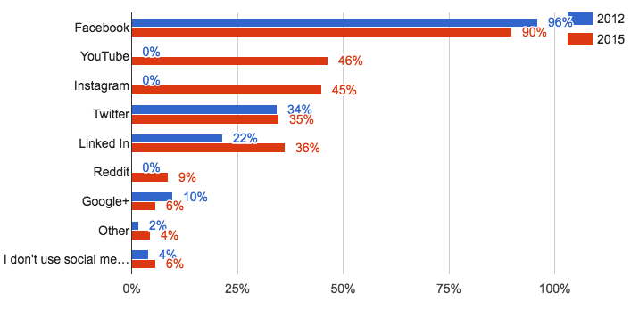
Social Media to Connect w/ Students
Notes:
Next we asked about social media usage in general:
Currently 87% of students use Facebook. 73% of students connected with other incoming students before the start of school. While a number of students commented about their dislike for Facebook & Social media in general, it’s obvious that a large percentage of students find it useful for connecting with their classmates before and after they arrive at school.
[NEXT] Faculties could consider assisting incoming students to connect with each other by pointing them to student-run social media groups in their welcoming emails. This can be especially helpful for out of town students looking for shared accommodations.

Slide 30
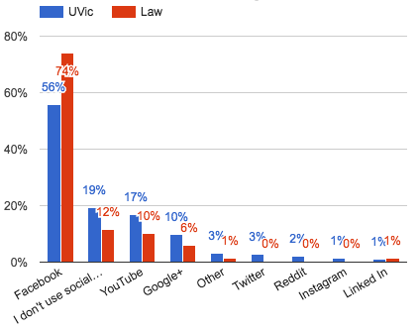
Social Media use for Assignments
More Investigation Needed
Notes:
Lastly we asked about social media usage to help with assignment completion:
Anecdotally I’ve seen FB and Youtube used by a study group to very effectively work through their homework
[NEXT] It would be very interesting to ask a few more questions to explore in more depth the different ways students are using social media to help them learn. This is something we will incorporate into next year’s survey.
Undergrad nurse cohort / Facebook / YouTube...

Slide 31
Opportunities...
Notes:
We’ve covered a lot of territory… Nows let’s look at some of the opportunities we’ve identified Based on analysis of the data:

Slide 32
Opportunity: eBooks & Open Access Materials
Notes:
Encourage the adoption of textbooks available in eBook formats, including Open Access materials. -> CALI’s eLandell & CALI Lessons

Slide 33
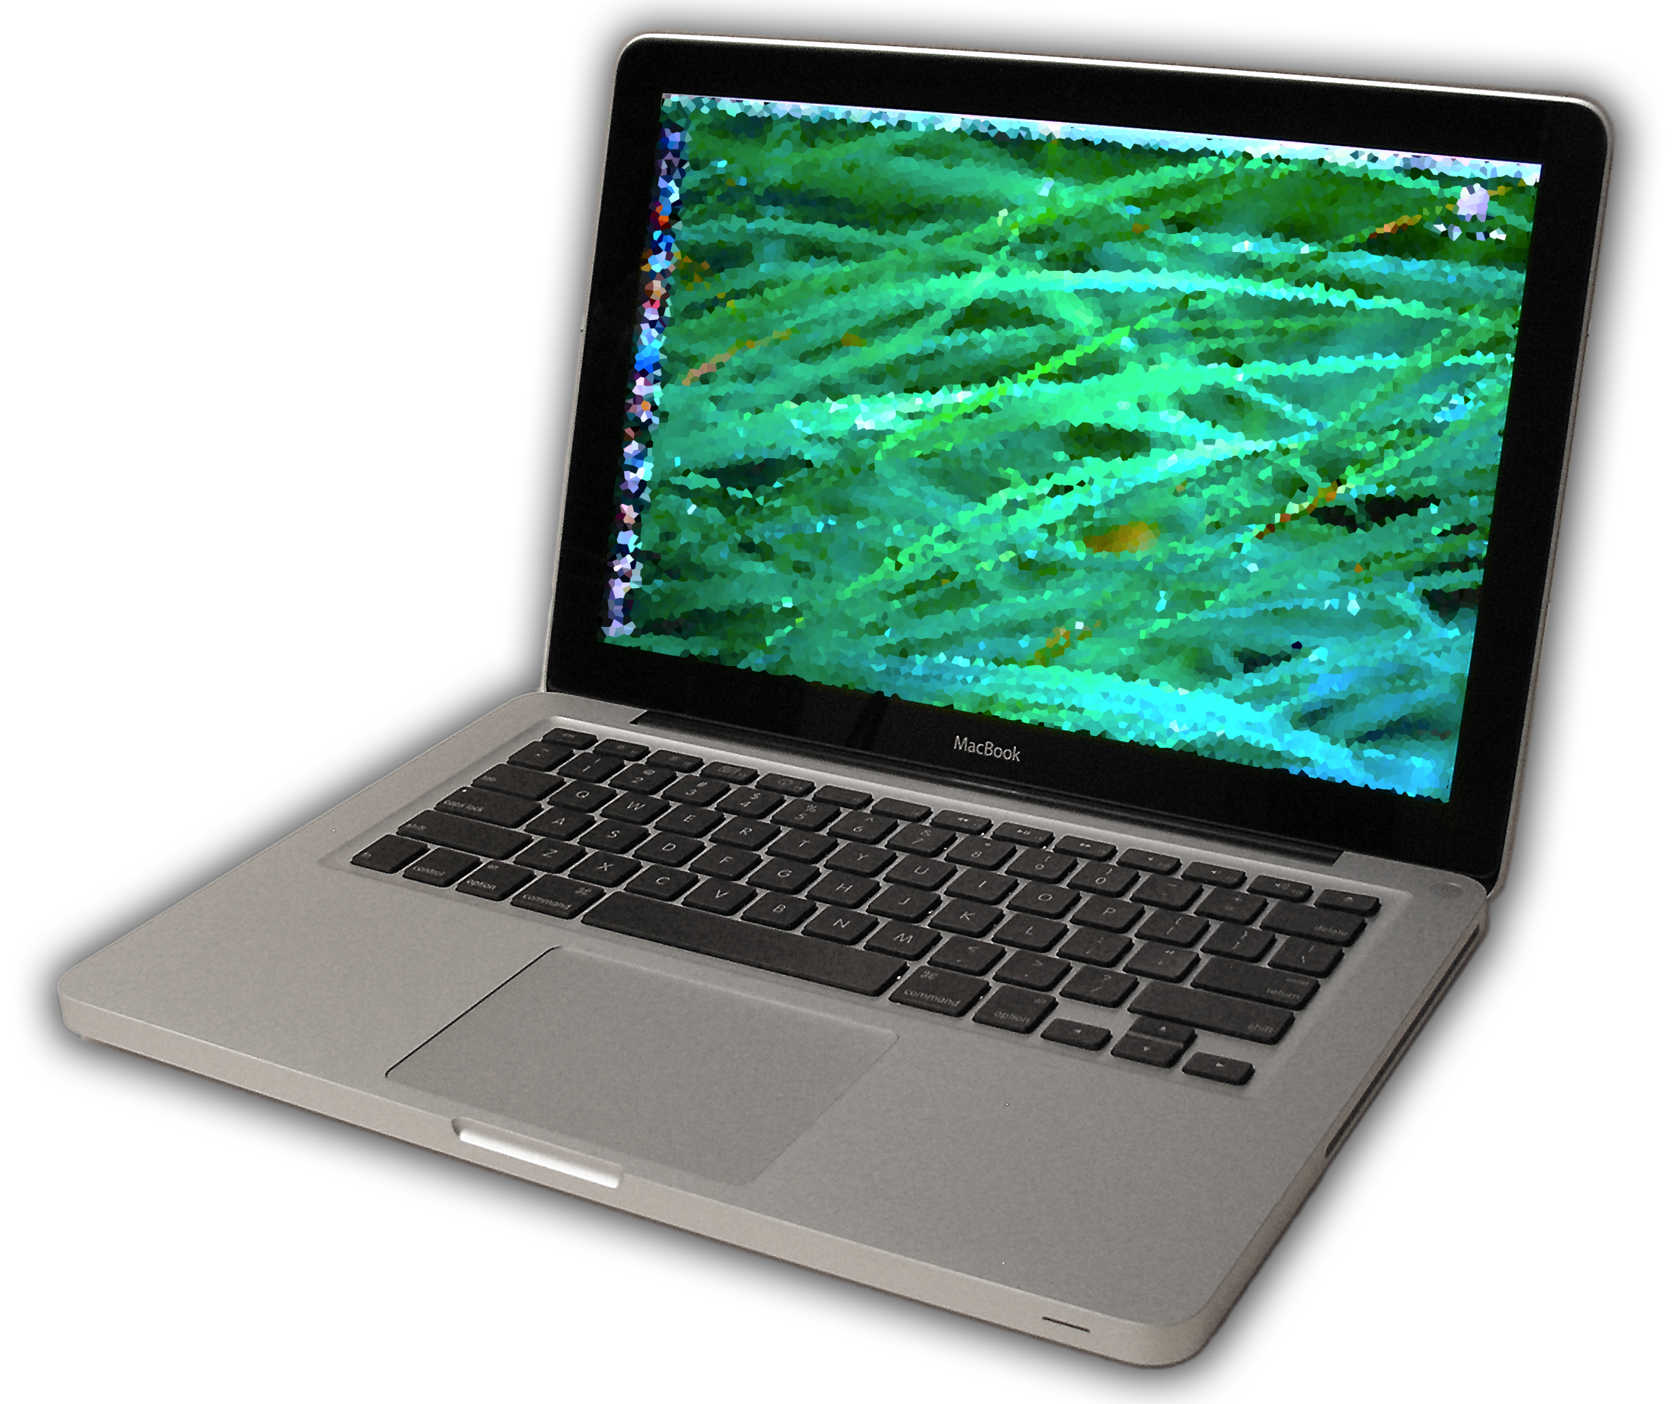
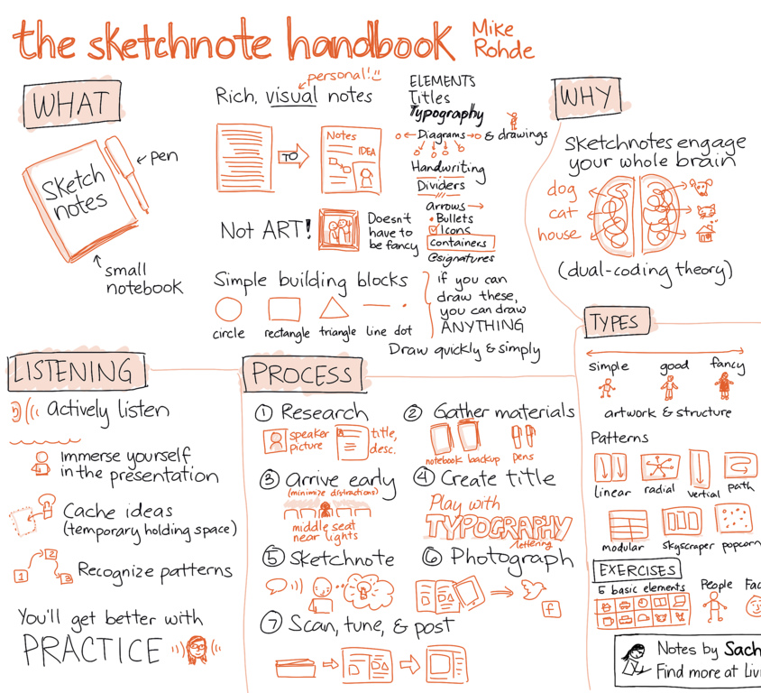
Student Note Taking Instruction
“When students are provided with an organizational structure in which to fit new knowledge, they learn more effectively and efficiently then when they are left to deduce this conceptual structure for themselves.”
Ambrose, S. A., Bridges, M. W., DiPietro, M., Lovett, M. C., Norman, M. K., & Mayer, R. E. (2010). How Learning Works: Seven Research-Based Principles for Smart Teaching (1 edition). San Francisco, CA: Jossey-Bass.
Notes:
[WILL]
Finding from recent study:
Laptops and scribes
Handwritten more active processing -- forced to summarize or paraphrase
“The most effective notes highlight an overall framework for a lecture and embellish that framework with critical specifics.”
Possible to teach this using laptops?
Alternate approaches: Sketchnoting is meant to be an inspirational idea, what would work for law students?
Provide them with organizational structure? Teach them how to develop visual organization structures and prompt them create them as needed?
But aren't students forced to create their own structure when sketchnoting?
Some instructors provide visual structures but there may be value in asking students to think actively about conceptual organization.

Slide 34
Provide Support to Faculty for more Active, Engaging Instruction
http://www.hiddensparks.org/hidden-sparks-blended-learning-lenses-course-2015/
(often tech enabled)
Notes:
Provide training to help faculty members leverage student technology to enable active, engaging pedagogies, moving away from the less effective lecture format
to Increase access to education,
and enable faculty to more easily differentiate their instruction to learners of differing ability.
Maybe start with new professors and more tech savvy & eager to experiment professors.

Slide 35
!=
Notes:
But Remember that technology is not a Cure-All for law school education,

Slide 36
http://www.fastweb.com/student-life/articles/the-5-students-you-meet-in-group-projects
http://campusscholars.com/
Notes:
However if the technology is used to increase student engagement, both in and out of the class..
And if we do things to increase student engagement, then I think we are on the right track.

Slide 37
Questions / Discussion
Will Monroe: will.monroe@law.lsu.edu
Rich McCue: rmccue@uvic.ca

