Slide 1
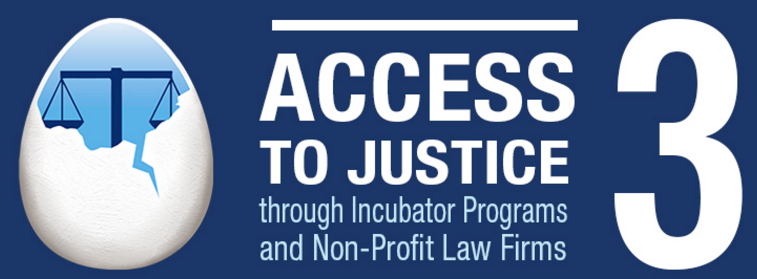
Incubators, Legal Education, Technology and Access to Justice
John Mayer Executive Director
Center for Computer-Assisted Legal Instruction
jmayer@cali.org
@johnpmayer
Fred Rooney
Incubator Champion At Large
fredprooney@gmail.com

Slide 2
Three Big Problems – All At Once
Crash of the Legal Job Market
Crisis in Legal Education
Access to Justice Gap
Notes:
1 in 5 stat from LSC, FY 2015 Budget Request (about 67 million people)
In IL alone- 383,000 low income households face 1.3 million legal problems each year. 83% of these go unmet. That is roughly 1.1 million legal issues every year.

Slide 3
Three Big Problems – All At Once
Crash of the Legal Job Market
Crisis in Legal Education
Access to Justice Gap
- Biglaw shrinking
- Rise of GCs
- Unsustainable model of
the billable hour
Notes:
1 in 5 stat from LSC, FY 2015 Budget Request (about 67 million people)
In IL alone- 383,000 low income households face 1.3 million legal problems each year. 83% of these go unmet. That is roughly 1.1 million legal issues every year.

Slide 4
Three Big Problems – All At Once
Crash of the Legal Job Market
Crisis in Legal Education
Access to Justice Gap
Notes:
1 in 5 stat from LSC, FY 2015 Budget Request (about 67 million people)
In IL alone- 383,000 low income households face 1.3 million legal problems each year. 83% of these go unmet. That is roughly 1.1 million legal issues every year.

Slide 5
Three Big Problems – All At Once
Crash of the Legal Job Market
Crisis in Legal Education
Access to Justice Gap
- Applications down
- Practice-ready lawyers - 2/3 go into solo practice - Calcified models of instruction
Notes:
1 in 5 stat from LSC, FY 2015 Budget Request (about 67 million people)
In IL alone- 383,000 low income households face 1.3 million legal problems each year. 83% of these go unmet. That is roughly 1.1 million legal issues every year.

Slide 6
Three Big Problems – All At Once
Crash of the Legal Job Market
Crisis in Legal Education
Access to Justice Gap
- Applications down
- Practice-ready lawyers - 2/3 go into solo practice - Calcified models of instruction
Notes:
1 in 5 stat from LSC, FY 2015 Budget Request (about 67 million people)
In IL alone- 383,000 low income households face 1.3 million legal problems each year. 83% of these go unmet. That is roughly 1.1 million legal issues every year.

Slide 7
Three Big Problems – All At Once
Crash of the Legal Job Market
Crisis in Legal Education
Access to Justice Gap
Notes:
1 in 5 stat from LSC, FY 2015 Budget Request (about 67 million people)
In IL alone- 383,000 low income households face 1.3 million legal problems each year. 83% of these go unmet. That is roughly 1.1 million legal issues every year.

Slide 8
Three Big Problems – All At Once
- 90% SRLs in Family Courts
Modest means cannot afford lawyers
50% eligible for legal aid cannot get help
Crash of the Legal Job Market
Crisis in Legal Education
Access to Justice Gap
Notes:
1 in 5 stat from LSC, FY 2015 Budget Request (about 67 million people)
In IL alone- 383,000 low income households face 1.3 million legal problems each year. 83% of these go unmet. That is roughly 1.1 million legal issues every year.

Slide 9
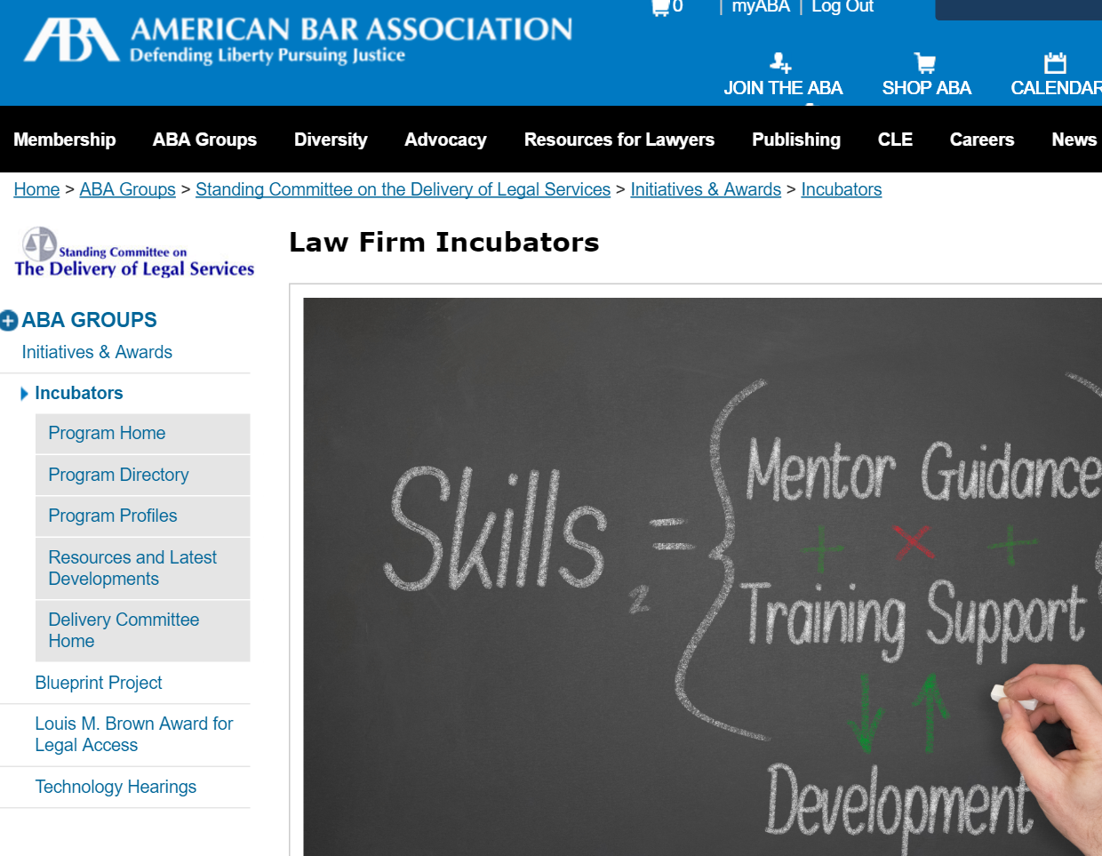
Incubators – Recent Past & Present

Slide 10
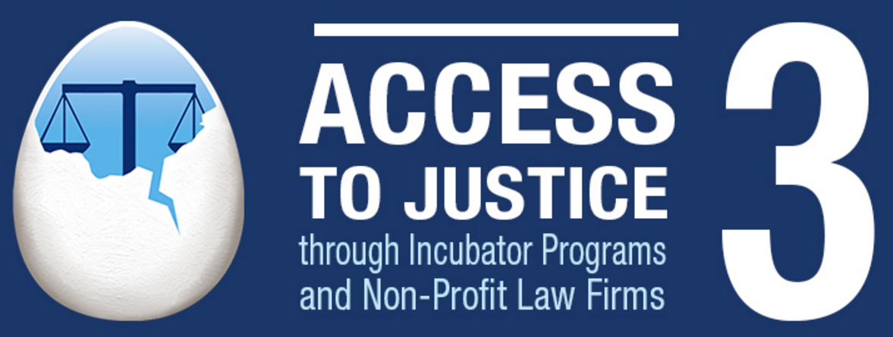
Incubators – Recent Past & Present

Slide 11
Incubators – Recent Past & Present
4th Year of Law School
a.k.a Legal Intern Year
(like MDs do)

Slide 12
Incubators – Future?
Content,
Tools,
Communities

Slide 13
Incubators – Future?
Content
Brief banks
Practice guides
Training materials
Form Letters
Incorporation Papers

Slide 14
Incubators – Future?
Tools
Document Assembly
Intake
Unbundled practice/Virtual representation
Triage
Vendor liaison (negotiation at scale?)

Slide 15
Incubators – Future?
Communities
Videos
Training
Shared experiences
Support
Similar vision/goals/purpose

Slide 16
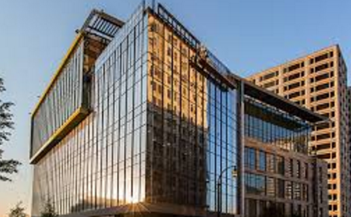
Incubators – Future?
Incubator
Content,
Tools,
Communities
Law Schools

Slide 17
Incubators – Future?

Slide 18
Incubators – Future?

Slide 19
+ Incubators
Law Practice Tech
Legal Content
Access to Justice
Civic Tech
Relevant to
Legal Education

Slide 20
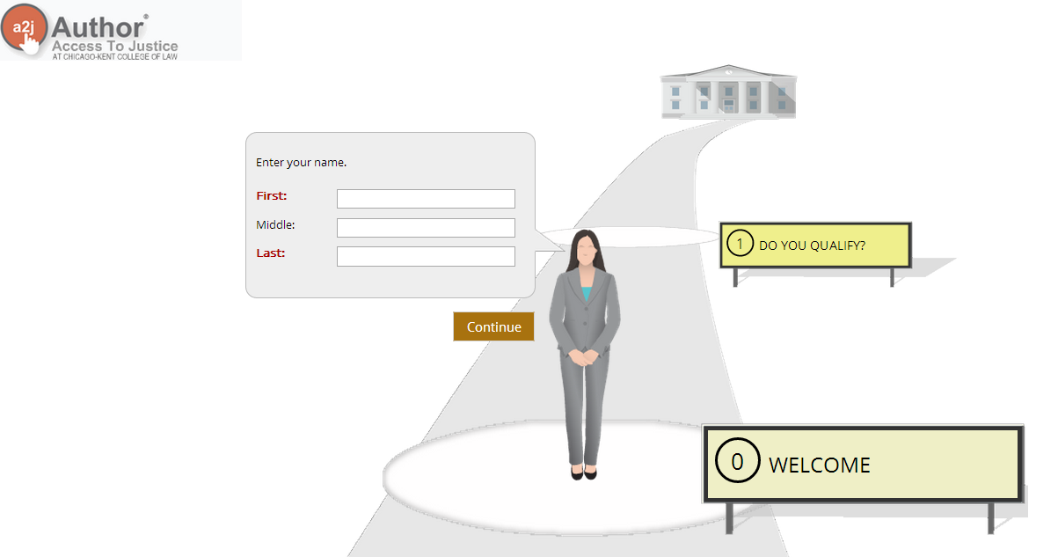

Slide 21
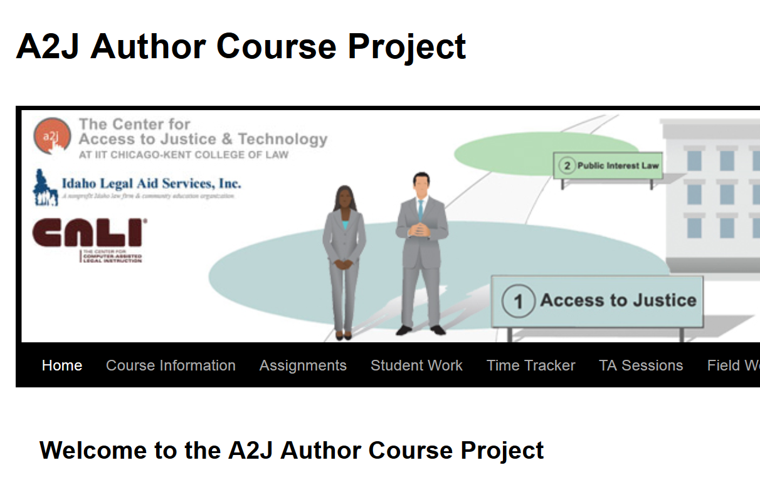
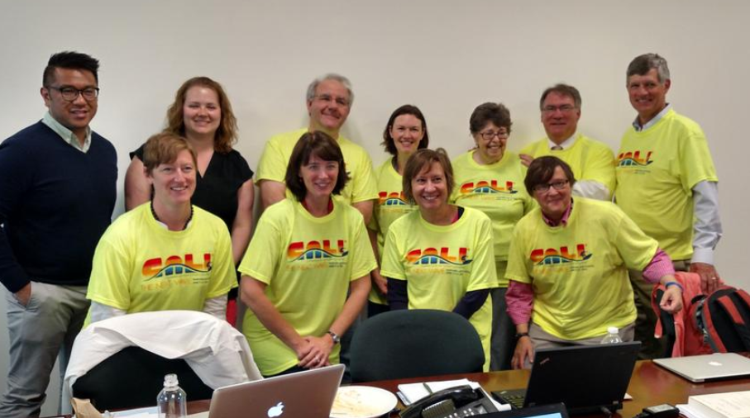
Incubator Farm System

Slide 22
Farm System
Law Students w/Practice Tech Course
Law Students
w/Clinic Exp.
Incubatees
Major Leagues
Law Practice Career

