Slide 1
Let’s Talk Hybrids
Mike Vogt
Manager for Instructional Technology
Pepperdine Law School

Slide 2
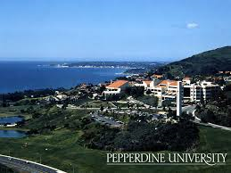
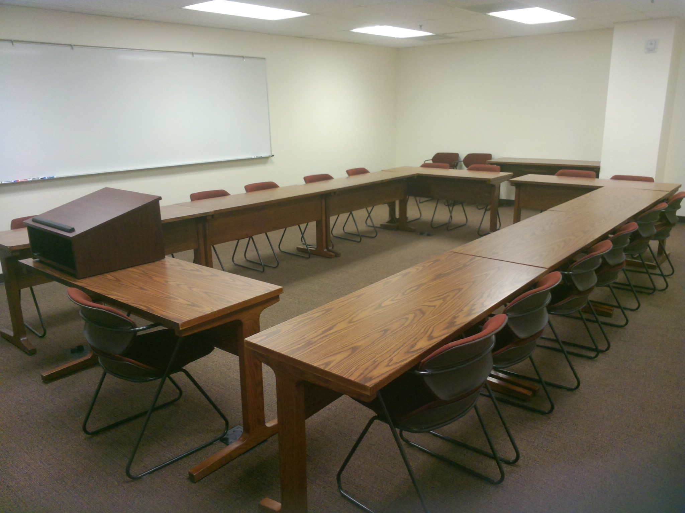
Pepperdine law school
Who we are
Where we are
What we do

Slide 3
Where did all the students go?

Slide 4
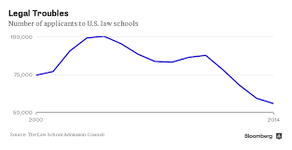
Declining state of affairs
Median Debt of Graduating Students, 141K*
Median Annual Salary for Graduating Students, 62K**
Sources:
* National Association for Law Placement
**The New America Foundation

Slide 5
Keeping the lights turned on The Why
Option 1. Reduce Faculty
Option 2. Reduce Staff
Option 3. Open up new revenue streams

Slide 6
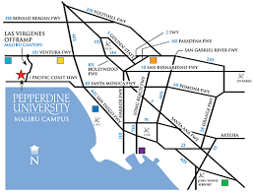
What sets us apart? Do’s & don’ts
Start with why
Don’t just sell a product, sell your mission
Don’t just target a field or demographic, target a learning style
Do find what makes your school unique, market differentiation, and do your research
Do start small, pilot courses, certificate, Masters, LLM, etc.

Slide 7
What are we doing??? The what
Set out to reach a new audience
Entertainment industry in LA
How can we best reach new audience
Accessibility to classes

Slide 8
Let’s get online The How & the where
What is everyone else doing?
Hybrid vs. Online
Pros & Cons – Heads up, Hybrids are easier, but sometimes less appealing
Online requires more tools and development time

Slide 9
Who Will show us the way?
Three Options
In-House
Hybrid model – Noodle
Turn-key solution – iLaw, Pearson, Academic Partnerships, etc.

Slide 10
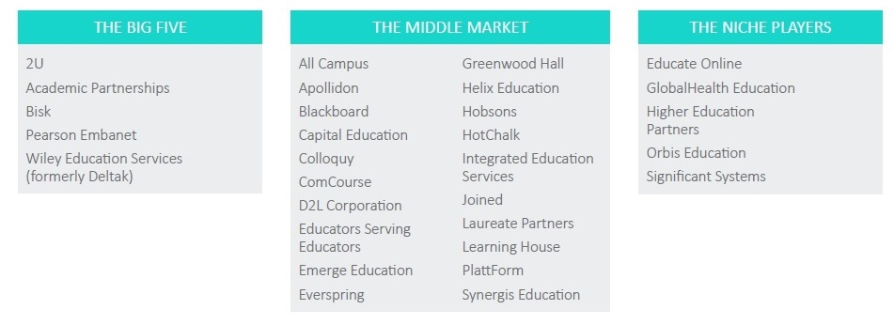
Source: www.insidehighered.com “Disrupting the enablers”

Slide 11
What can your it department do to help?
Three stages of support: Before, during, and after
Determine what is needed at each stage
Start asking questions
Be prepared for course corrections

Slide 12
What can your it department do to help?
Prepare list of technical considerations
Develop a checklist for implementation
Develop and share resources
Develop Expertise
Develop relationships/partnerships
Be available!

Slide 13
Resources
Distance Learning in Legal Education: Design, Delivery and Recommended Practices (2015 Edition). - http://goo.gl/lQ6hwv
How to Develop Accessible E-Learning - https://cielo24.com/ty-develop-accessible-e-learning/

Slide 15
Questions & Resources
Syracuse University Law School plans to move online https://www.insidehighered.com/quicktakes/2016/04/19/syracuse-university-plans-online-jd-degree
Noodle Partners shaking things up: https://goo.gl/zeccCo
How for-profit OPM’s profit off of education: http://goo.gl/Gr7Fsc

